Slide 1



Samuel Molahloe
@smolahloe
Customizing Office 365 UI with SharePoint Framework (SPFx) & SPFx Extensions

Slide 2
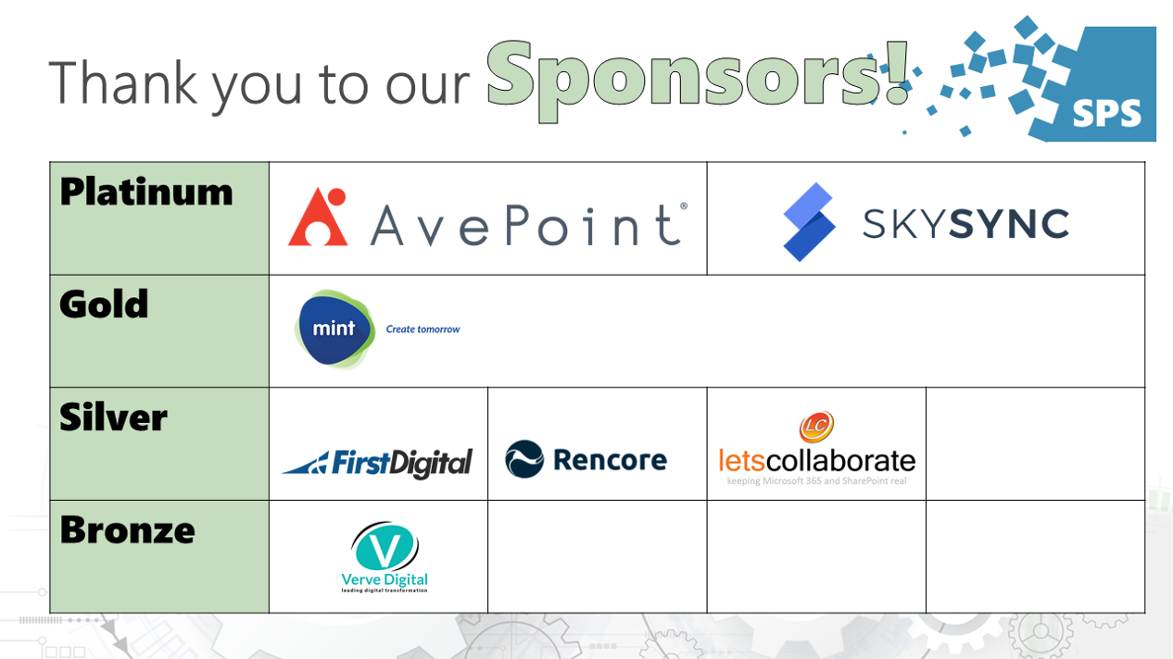

Slide 3
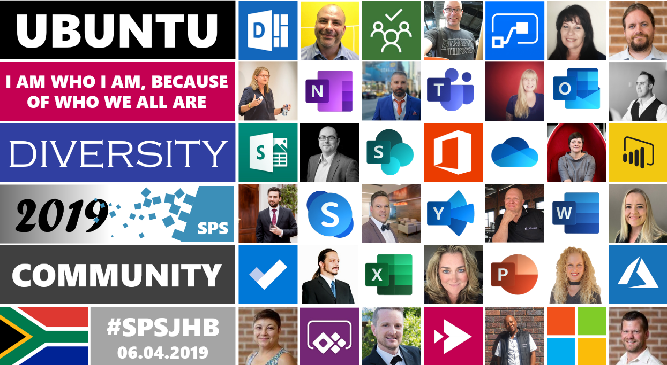

Slide 4
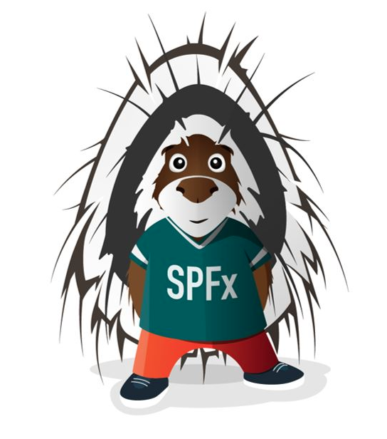
Customizing Office 365 UI with SharePoint Framework (SPFx) & SPFx Extensions

Slide 5
Talk Layout
What is SharePoint Framework (SPFx)?
Why SharePoint Framework (SPFx)?
Set Up A Development Environment
Building A WebPart
Deploying and Shipping SPFx WebPart.
Best Practices

Slide 6
What is SharePoint Framework (SPFx)?
Notes:
SharePoint has evolved a lot over the years, which has caused a fair amount of confusion. SharePoint Framework is the latest iteration of the Office developer story that offers modern client side development methodologies (node, typescript, etc.) applied to SharePoint and Office 365 development.
The SharePoint Framework (SPFx) is a page and web part model that provides full support for client-side SharePoint development, easy integration with SharePoint data, and support for open source tooling. With the SharePoint Framework, you can use modern web technologies and tools in your preferred development environment to build productive experiences and apps that are responsive and mobile-ready from day one.

Slide 7
Why SharePoint Framework (SPFx)?
History of SharePoint Development
Development Environment
Notes:
SharePoint Portal Server
- Based on SharePoint Team Services

Slide 8
Why SharePoint Framework (SPFx)?
History of SharePoint Development
SharePoint Portal Server 2003
Built on .NET 2.0
Server-side Only
Customizations Ran in Full-Trust
Manual Deployment
Notes:
- Customization could do anything on the server
- Customizations also ran in the same process as the SharePoint which implied if anything went wrong the entire server crashed

Slide 9
Why SharePoint Framework (SPFx)?
History of SharePoint Development
Office SharePoint Server 2007
Free version based WSS 3.0
Server-side Only
Full-Trust
New Plugin Model: Features
New Deployment Model: Solutions
Notes:
Two new features were introduced that triggered a wave of SharePoint development and Extensibility
A new plugin model called “Features” allowed customizations to lists / libraries
Solutions allowed packaging of Features and deployed to the server (WSP)
Around this time, every company was hosting its own SharePoint Deployment and it was not a trivial task and as such companies started looking for SharePoint hosting options and Microsoft naturally responded to some of it’s larger customers. It was not cost-effective so the started looking at multi-tenant hosting options.
Multi-tenant refers to using the same SP deployment to host two or more customers
The way customizations were being developed posed a problem

Slide 10
Why SharePoint Framework (SPFx)?
History of SharePoint Development
Office SharePoint Server 2010
Based SharePoint Foundation 2010
Sandboxed Solutions
Farm / Fully-Trusted Solutions
Introduction of Client Side API (CSOM)
Notes:
Introduced a lot of multi-tenant capabilities to SharePoint and it was around that time that Microsoft started offering the beginnings of Office 365 (SharePoint Online) at the time it was called Business Productivity Online Services
Sandbox Solutions protected the core SharePoint process
Sandbox solutions were too limiting to the point that developers reverted back to Farm Solutions
CSOM was difficult which lead to some open-source libraries like SPServices

Slide 11
Why SharePoint Framework (SPFx)?
History of SharePoint Development
Office SharePoint Server 2013 & SharePoint Online
Based SharePoint Foundation 2013
Heavy investment in Client-Side APIs
REST-based APIs
New Development Model
SharePoint Hosted Add-in Model (App Model)
Provider Hosted Add-in
Notes:
Did not support any server-side
Provider hosted add-ins were hosted outside of SharePoint

Slide 12
Development Environment Setup
NodeJs
Development Toolchain
Yeoman
Gulp
Webpack
SPFx Generator
Code Editor
Notes:
SharePoint Framework like all modern web frameworks runs on NodeJs (LTS)
And only NodeJS version 8 is supported.
Node.js is an open-source, cross-platform JavaScript run-time environment for executing JavaScript code server-side.
Node.js is a JavaScript runtime built on Chrome’s V8 JavaScript engine.
Node.js uses an event-driven, non-blocking I/O model that makes it lightweight and efficient.
npm is a Node package manager (equivalent of Nuget)

Slide 13
Development Environment Setup
NodeJs
Development Toolchain
Yeoman
Gulp
SPFx Generator
Code Editor
Notes:
Yeoman
Yeoman is scaffolding/templating engine as the name implies, it generates initial project structure
It has a registry of templates
Examples
npm install –g yo generator-electron
yo electron

Slide 14
Development Environment Setup
NodeJs
Development Toolchain
Yeoman
Gulp
SPFx Generator
Code Editor
Notes:
Yeoman and Gulp
Yeoman is scaffolding/templating engine
- Initial project structure
-
Gulp
- Task runner (MSBuild)

Slide 15
Development Environment Setup
NodeJs
Development Toolchain
Yeoman
Gulp
SPFx Generator
Code Editor
Notes:
Webpack
SPFx treats Webpack as a black-box. You don’t need to know the internals
Loads appropriate modules
Bundles modules
-

Slide 16
Development Environment Setup
NodeJs
Development Toolchain
Yeoman
Gulp
SPFx Generator
Code Editor
Notes:
Any
Lightweight and very fast, fluent and has plenty of extensions
There’s an active community
Alternatives
- Atom
- Vim
- Sublime Text

Slide 17
Development Environment Setup
NodeJs
Development Toolchain
Yeoman
Gulp
SPFx Generator
Code Editor
Notes:
SharePoint Framework Generator
Scaffold SPFx Project
yo @microsoft/generator-sharepoint

Slide 18
Demonstration
Building a Web Part Solution
Notes:
yo @microsoft/generator-sharepoint
Tenant-scope Deployment
Available immediately in the Web Part Picker once deployed to the App Catalog

Slide 19
Demonstration
Property Pane Metadata
Notes:
The PropertyPane is made up of
Page - Allows you to separate complex interactions and divide them across one or multiple pages. Pages has sub-metadata as Header and Groups.
- Header - Defines the title of the property pane.
Groups - Groups together various property fields.
SharePoint Framework has the helper class spHttpClient, which can be utilized to call REST API requests against SharePoint. We will use REST API: “/_api/web/lists/GetByTitle('EmployeeList')/Items” to get the list items from SharePoint List.

Slide 20
Questions????
Notes:
The PropertyPane is made up of
Page - Allows you to separate complex interactions and divide them across one or multiple pages. Pages has sub-metadata as Header and Groups.
- Header - Defines the title of the property pane.
Groups - Groups together various property fields.
SharePoint Framework has the helper class spHttpClient, which can be utilized to call REST API requests against SharePoint. We will use REST API: “/_api/web/lists/GetByTitle('EmployeeList')/Items” to get the list items from SharePoint List.

Slide 21
Useful Links
Demo
https://github.com/smolahloe/sps2019
Office Developer Program
https://developer.microsoft.com/en-us/office/dev-program
NodeJS LTS
https://nodejs.org/en/blog/release/v8.15.1/
Code Editors https://code.visualstudio.com/ https://atom.io/
Office UI Fabric
https://developer.microsoft.com/en-us/fabric#/styles/icons
Notes:
The easiest way of getting a ”Free” tenant is by subscribing to the Office Developer program
- This program allows you 12 month access to Office 365 https://developer.microsoft.com/en-us/office/dev-program

Slide 22

Notes:
Tenant-scope Deployment
Available immediately in the Web Part Picker once deployed to the App Catalog

